Slide 1
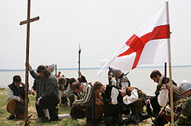
The Planting of English America
(1500-1733)
Chapter 2

Slide 2
Focus Questions
Why did England seek to begin colonization of the New World?
How did the slave system develop in British North America?
What caused the cultural clashes between the English colonists and the Native Americans in the 17th Century
How did the development of the British colonies create separate and distinct identities?

Slide 3
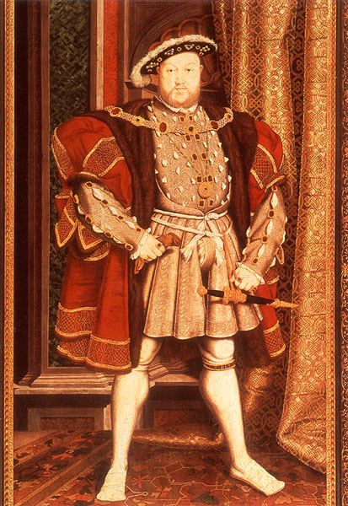
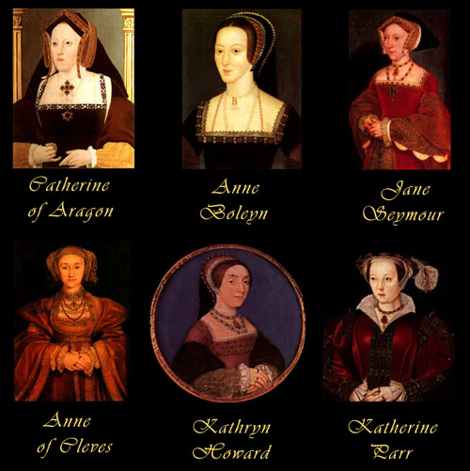
England before colonization
Spain and England allies and England had little interest
King Henry VIII
  “Off with her head”
Protestant Reformation
King Henry VIII

Slide 4
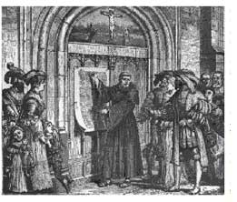
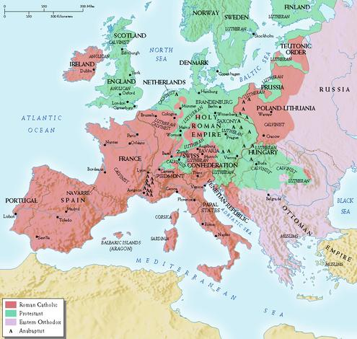
Protestant Reformation

Slide 5
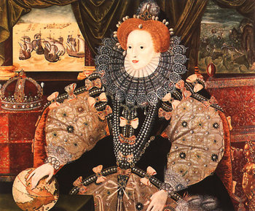
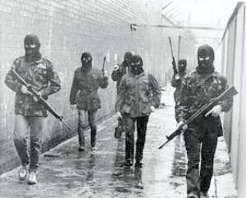
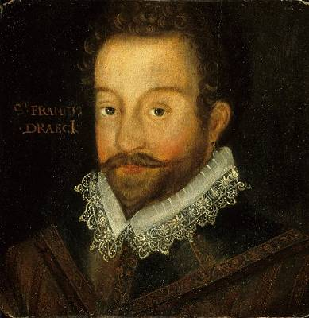
Queen Elizabeth I Queen of England
(1533-1603)
“Virgin King”- Protestant
Puts down Irish rebellion
  Atrocities and policies
Rivalry with Spain increases
Elizabeth encourages raiding on ships and settlements
  Sir Francis Drake
Top: “Virgin Queen”
Bottom Left: Sir Francis Drake
Bottom Right: IRA guerilla rebels

Slide 6
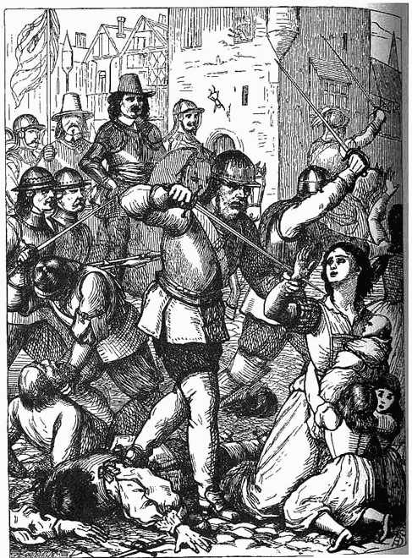
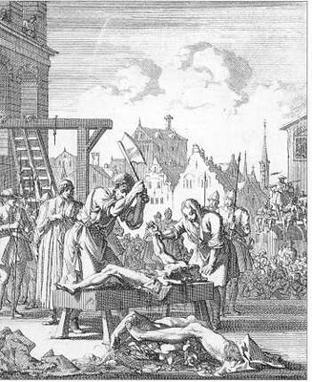
Campaign against the Irish

Slide 7
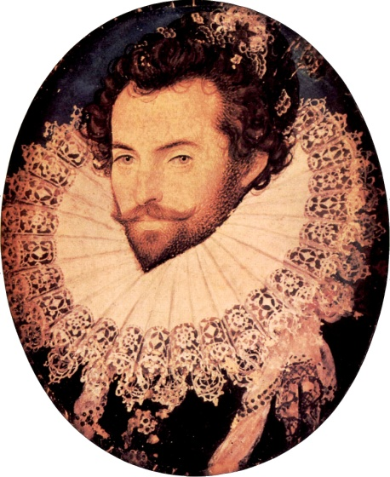
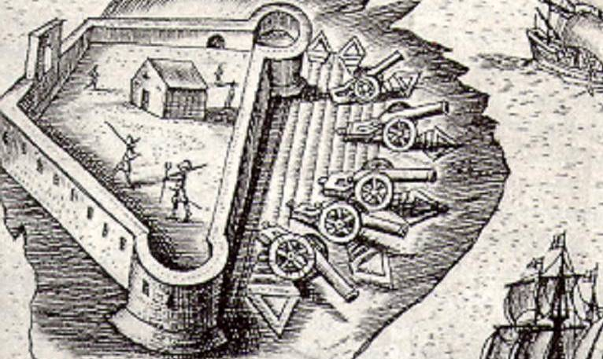
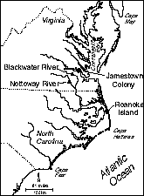
Roanoke Island
England’s first attempt at colonization
Sir Walter Raleigh landed in 1585 off of coast of Virginia
Roanoke Island mystery
https://www.youtube.com/watch?v=kFMnMEYwqIM
Top Left:
Fortifications at Roanoke Island
Top Right:
Sir Walter Raleigh
Bottom: Roanoke Island Map

Slide 8
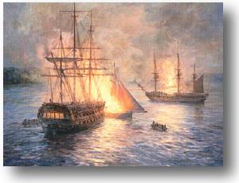
It’s a showdown
Phillip II King of Spain rich with gold and silver assembles “invisible armada” to destroy Virgin Queen
In 1588, 130 ships land off England’s coast
Protestant Wind and Sea Dogs destroy ships
End of Spanish conquest
Spanish Armada decimated

Slide 9
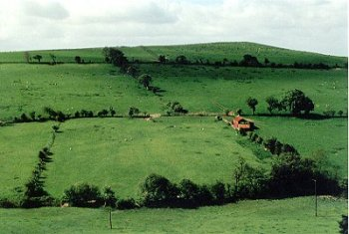
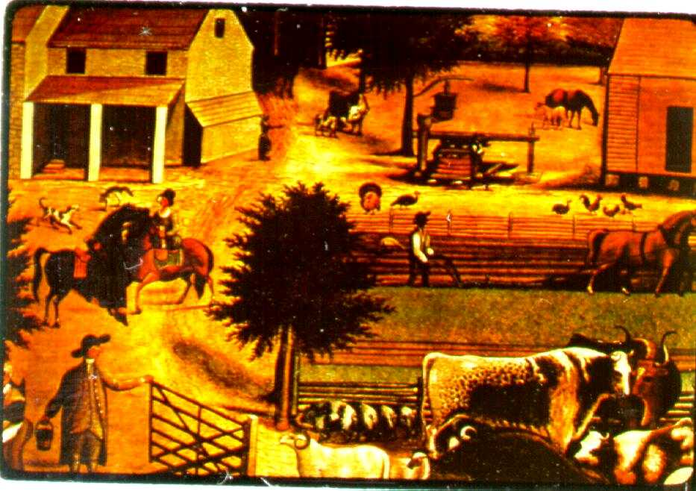
What’s happening in England?
Motives for colonization
  Expanding population (adding 1 million every 50 years)
  Enclosure
  Laws of Primogeniture
  Formation of Joint Stock Company
  Religious Freedom
Farm Enclosures

Slide 10
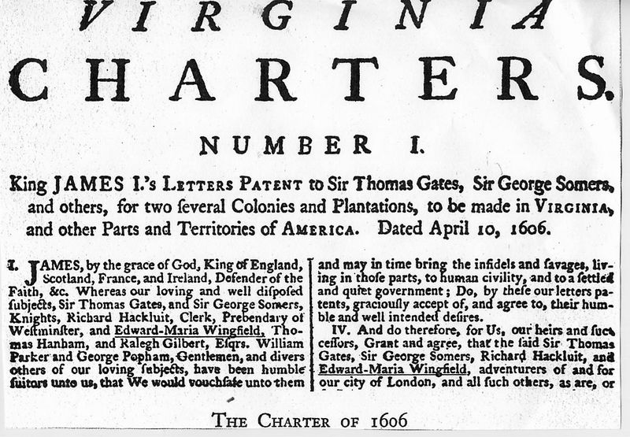
Virginia
Charter of the Virginia Company stated that English were granted same rights as if they stayed in England
This right was incorporated into future documents and assured them they still were “Englishmen”
  Why is this ironic?

Slide 11
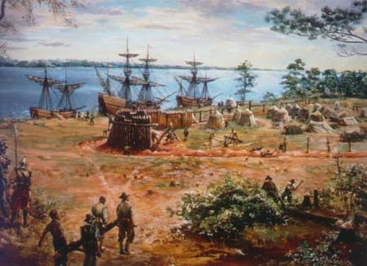
Virginia
In 1606 a total of 3 ships leave England bound for America (What were they looking for, and who would gain?)
In 1607 they land at the bank of the Chesapeake and are attacked by Indians
After they flee they land along James River and name it Jamestown after King James I
At first the climate seemed mild, the Indians friendly. As John Smith wrote, "heaven and earth never agreed better to frame a place for man's habitations.“
Pictured are the three ships that brought the original settlers to Jamestown in 1607: the Susan Constant, the Godspeed, and the Discovery.

Slide 12
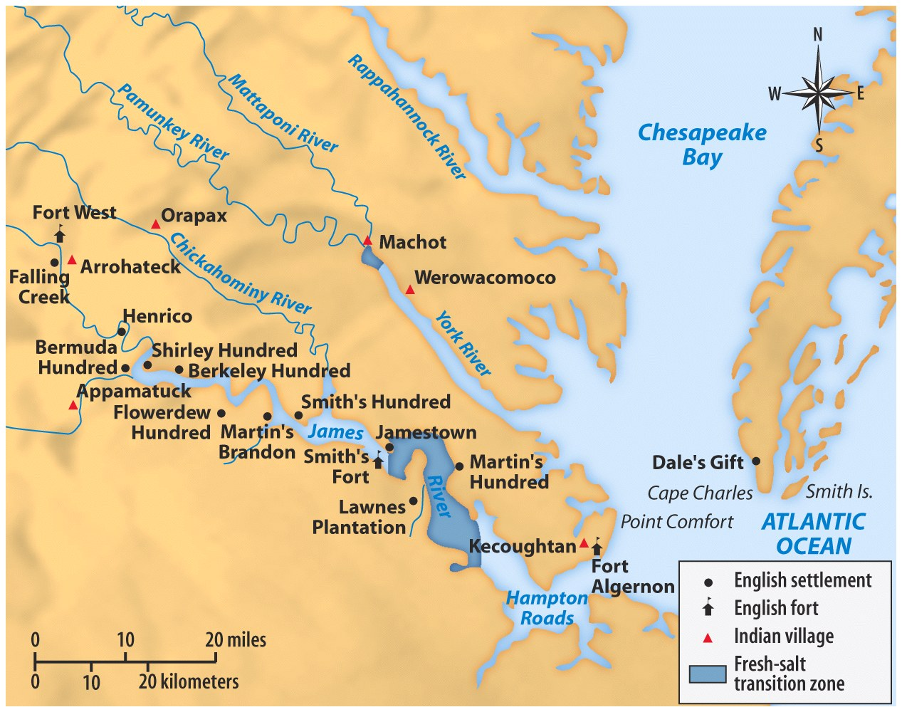
Why is this an excellent site?
Why is this a poor choice?

Slide 13
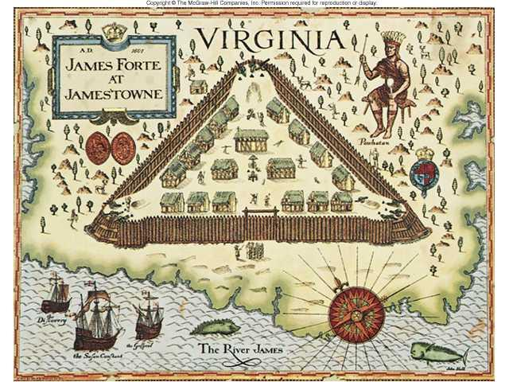
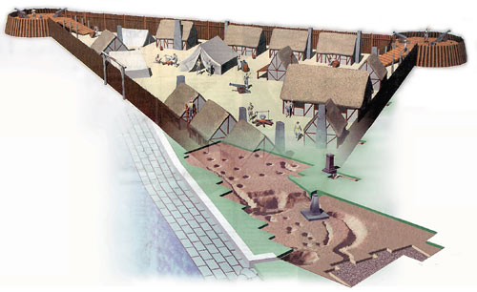
Jamestown Site
Left: Drawing early Jamestown
Right: Computer generated image of Jamestown

Slide 14
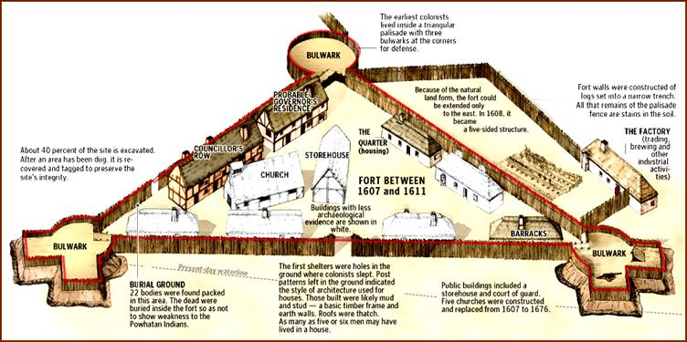

Slide 15
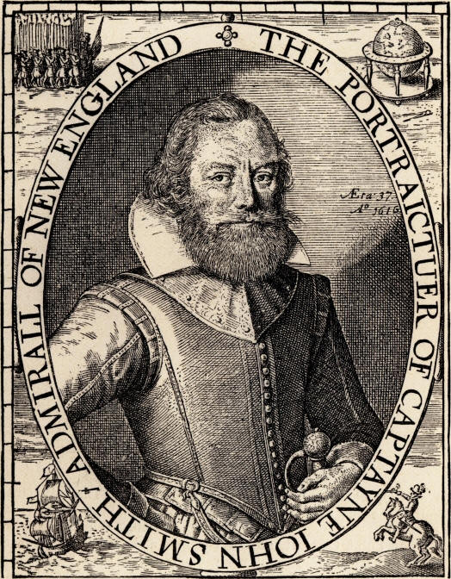
Help Wanted!
Looking for a strong leader to whip in shape spoiled, starving, and dying colonists in order to make a profit for investors!
Captain John Smith gets the job!
  “He who does not work shall not eat”

Slide 16
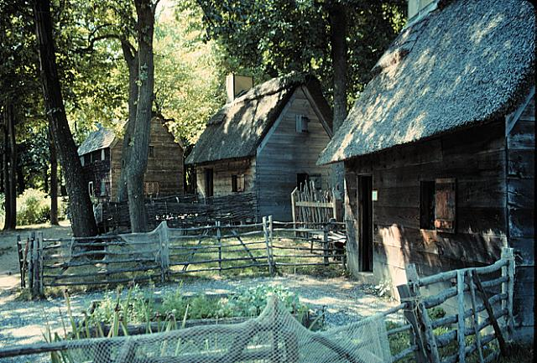
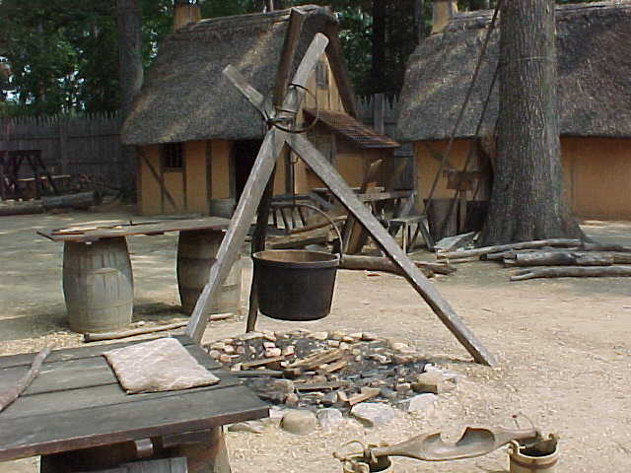
Jamestown Housing and Settlement

Slide 17
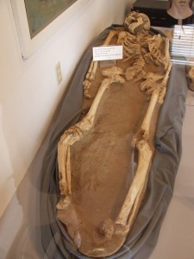
Death in Jamestown
40 died on voyage over, and another ship lost its leaders and supplies from Bahamas
Settlers were “Gentleman” who refused to farm and looked for gold
No gold and dozens died!
Body of early Jamestown settler

Slide 18
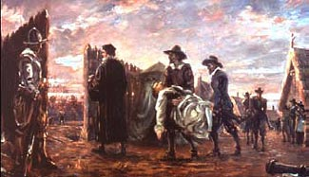
The Starving Time
1607: 104 settlers
1608: 38 survivors
1609: 300 immigrants
1610: 60 survive
1610-1624: 10,000 immigrants
1624: population: 1200
Life expectancy: 40 years old
80% infant mortality rate
Colonists taking dead bodies out of Jamestown during “Starving Time”

Slide 19
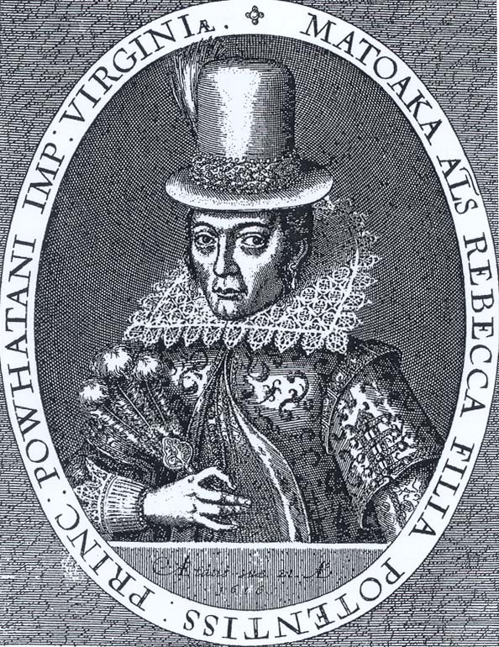
Pocahontas (Story next slide)
Left: Pocahontas “Saves” smith, Right: A 1616 engraving of Pocahontas (Pocahontas's formal names were Matoaka (or Matoika) and Amonute)

Slide 20
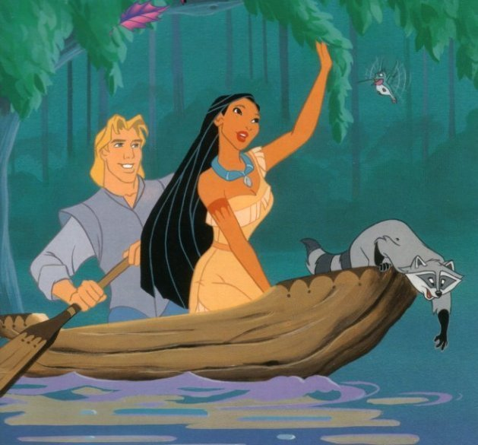
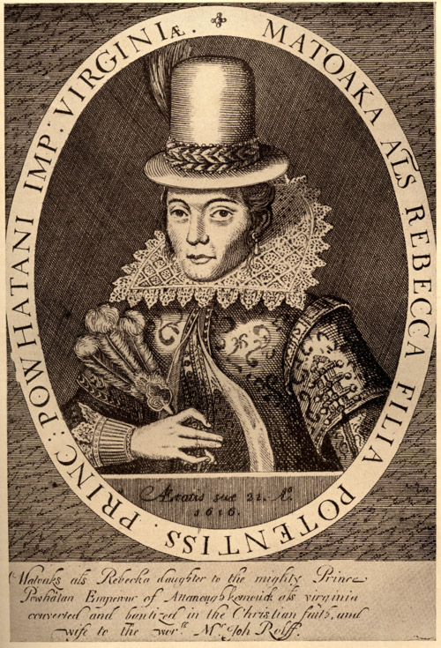
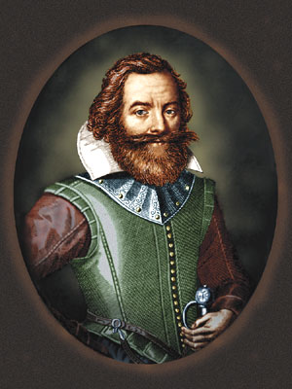
Saved by an Indian Maiden
The story begins when Smith and two English companions are ambushed by Indians. After killing his two companions, the Indians take Smith to their chief, Powhatan. After two months in captivity, Powhatan determines to have the Englishman clubbed to death in a ritual ceremony. According to Smith, the plan is thwarted only when the chief's daughter, Pocahontas (then aged 11 or 12), throws herself between him and his attackers causing her father to relent. Smith published his account of the incident in 1624. It is the only description of the event we have and some historians doubt its authenticity. However, the account permanently etched his name in American folklore. Throughout the account; Smith refers to himself in the third person:

Slide 21
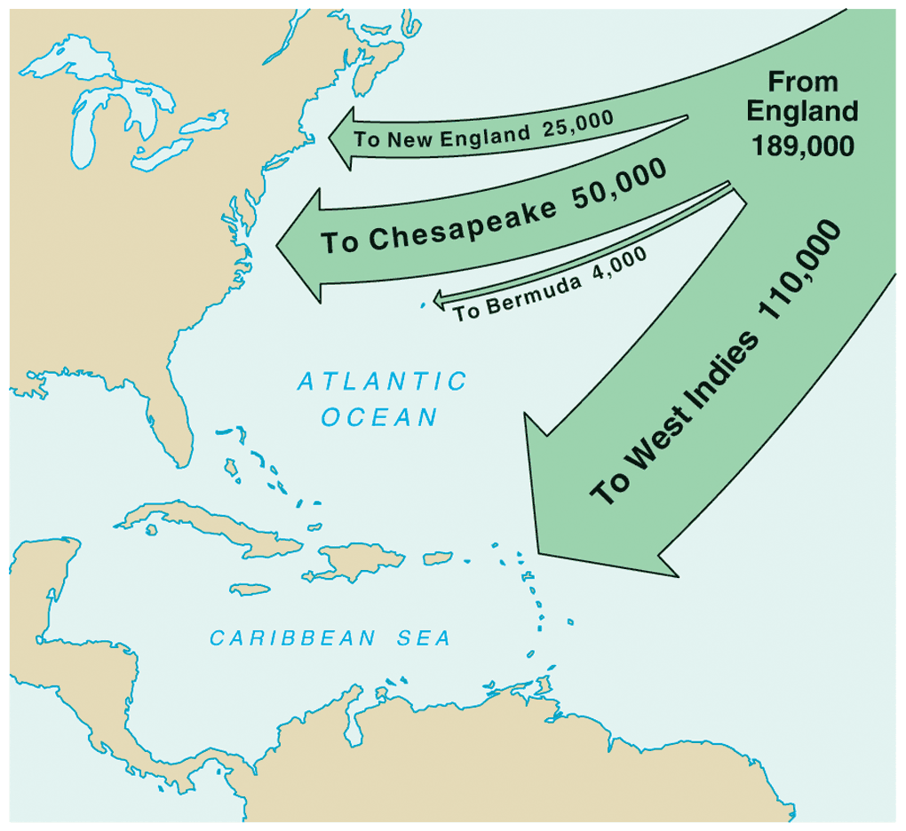
English Migration 1610-1660

Slide 22
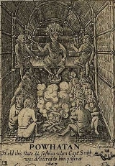
Chief Powhatan
Indians were named Powhatan by settlers
Considered whites allies at first
Helped them survive early in the starving time
American settlers began to attack Indian food supplies and villages, Powhatan turns on them
Powhatan takes advantage of “the starving time”

Slide 23
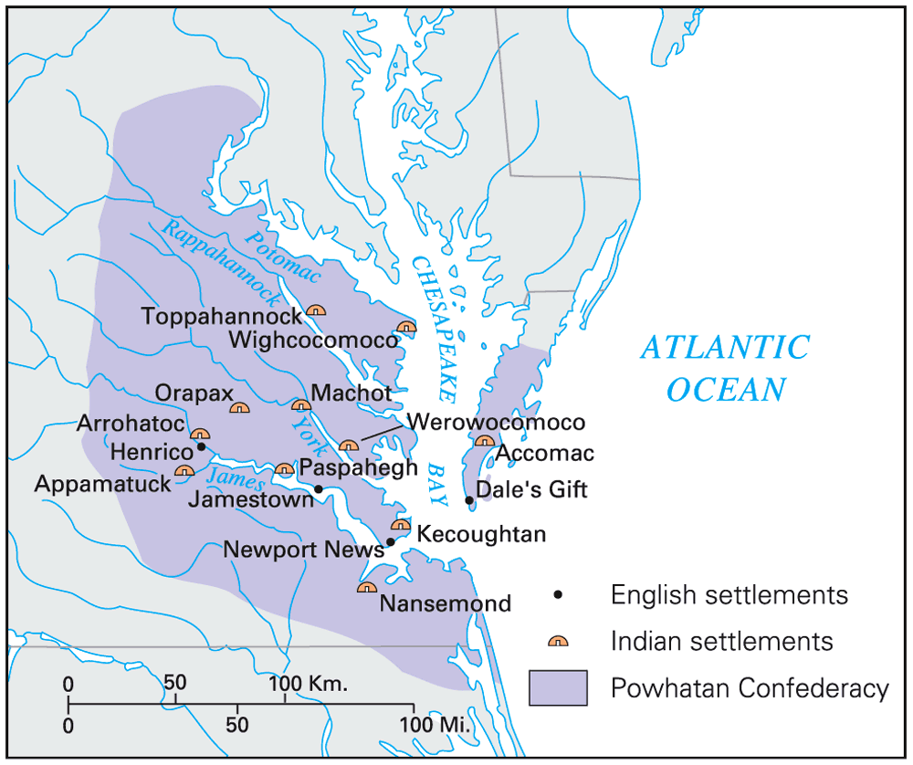
Powhatan Confederacy

Slide 24
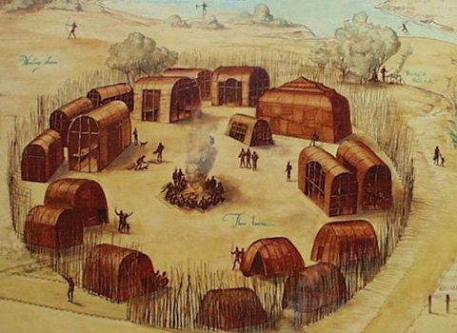
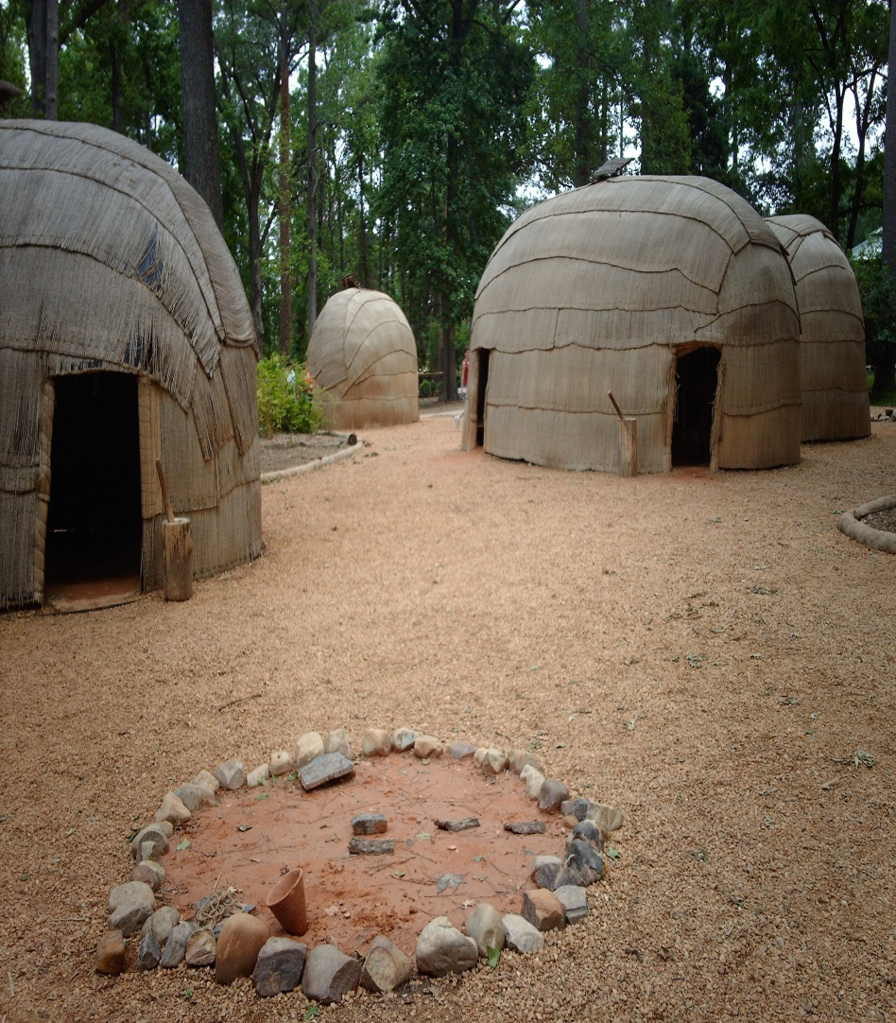
Powhatan Village

Slide 25
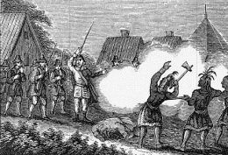
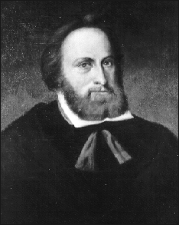
Clash of Cultures
First Anglo-Powhatan War
Lord De La Warr arrived in 1610 with orders to make war on Indians
Used “Irish Tactics” by raiding and burning villages, confiscating Indian property, and burning Indian crops
Peace reached in 1614 with capture and eventual marriage of Pocahontas and John Rolfe
“be disarmed (and) have his arms broken and his tongue bored through with an awl (and) shall pass through a guard of 40 men and shall be butted (with muskets) by every one of them and at the head of the troop kicked down and footed out of the fort.” –Punishment for criticizing Governor De La Warr

Slide 26
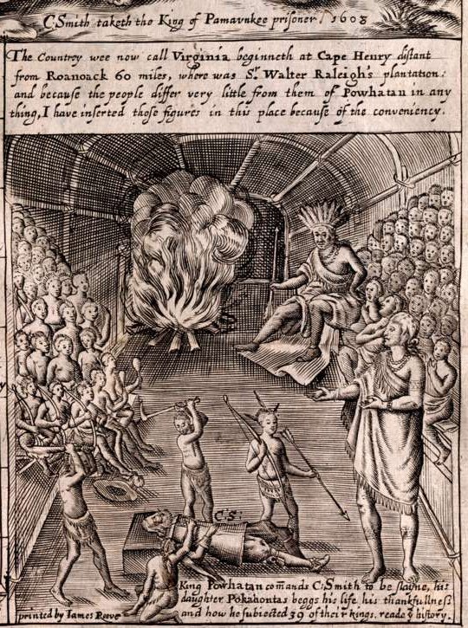
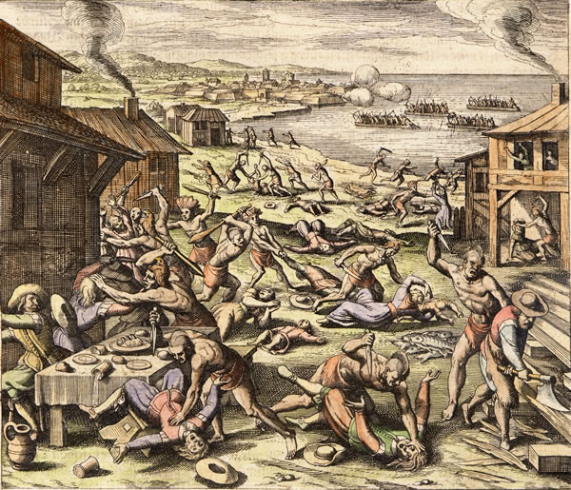
Powhatan Uprising of 1622
Indians attacked English killing 347 (including John Rolfe)
Left: Colonist portrayal of Indians, Right: Painting Powhatan uprising of 1622

Slide 27
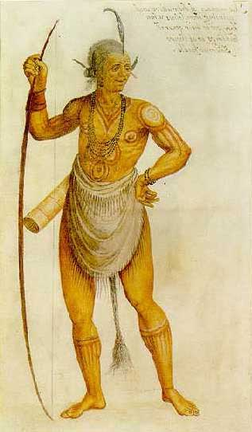
Second Anglo-Powhatan War
1644-1646 Powhatan’s attempted to finally dislodge the settlers
They lost and were forced to sign Peace Treaty of 1646
  Removed Indians from their land and set them up in “Reservations”
Right: Chief Powhatan (c. June 17, 1545 – c. 1618), whose proper name was Wahunsenacawh

Slide 28
Why were the Indian’s defeated?
Disease- Within 50 years they lost 90% of population
Disorganization- Wanted firearms and fought one another rather than band together
Disposability- Indians had nothing the settlers considered useful anymore.

Slide 29
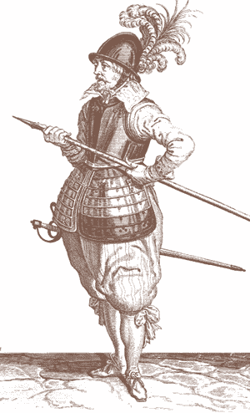
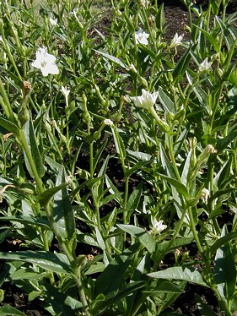
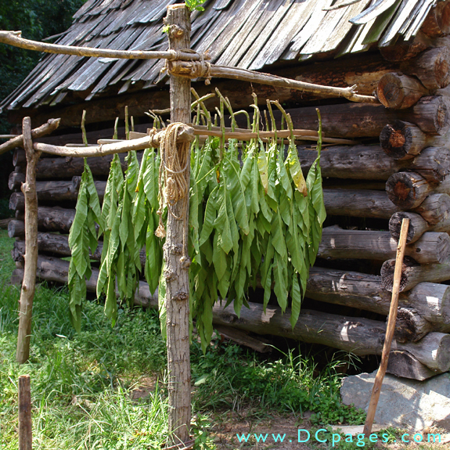
Virginia
What made the colony prosperous? (Video)
http://www.youtube.com/watch?v=9nKRHV23Mqc&list=PLDC790008118A3D4A
Left: John Rolfe , Center: Tobacco Plant, Right: Tobacco drying

Slide 30
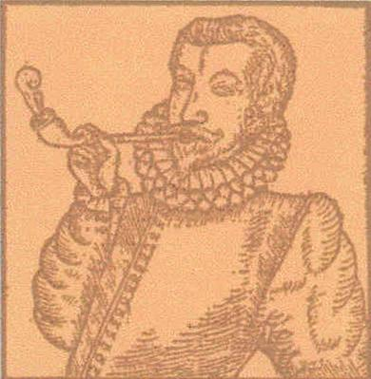
Early Tobacco Production
1618 — Virginia produces 20,000 pounds of
tobacco.
1622 — Despite losing nearly one-third of
its colonists in an Indian attack,
Virginia produces 60,000 pounds of
tobacco.
1627 — Virginia produces 500,000 pounds
of tobacco.
1629 — Virginia produces 1,500,000 pounds
of tobacco.
What problems do you foresee for this colony?

Slide 31
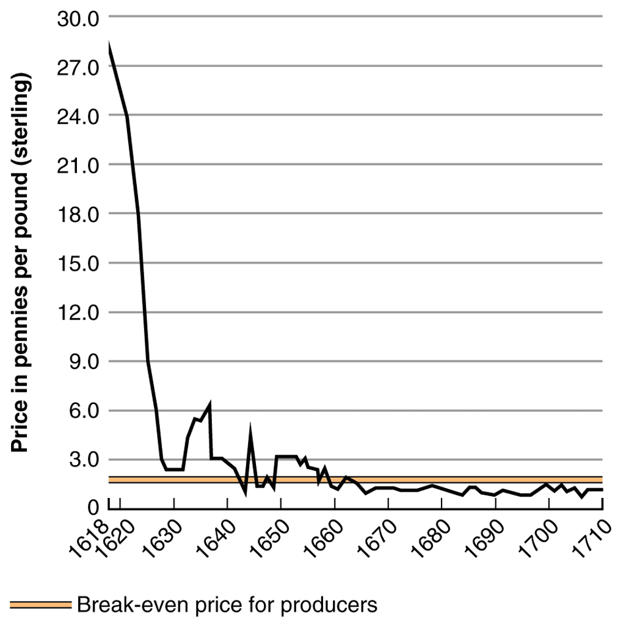
Problems with Tobacco
Virginia one crop economy
Had to import their food
Prices decline
Ruins soil
Need for cheap abundant labor- But from where?

Slide 32
Headright System
Indentured Servitude
  Headright System
    Each owner who paid for passage would get 50 acres of land
    5-7 year contract
    Could not marry
    Would get “freedom” reward at end of contract
    90% death rate before freedom

Slide 33
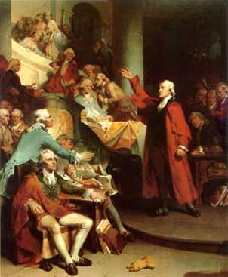
Why was 1619 a pivotal year for the Virginia Colony?
House of Burgesses
  Modeled on the House of Commons in England
  Regulated the colony and commerce
  Leading planters ruled like the House of Lords, and even began to initiate legislation although high death rates ensured nobody held to much power
    What problems do you foresee?
Meeting House of Burgesses

Slide 34
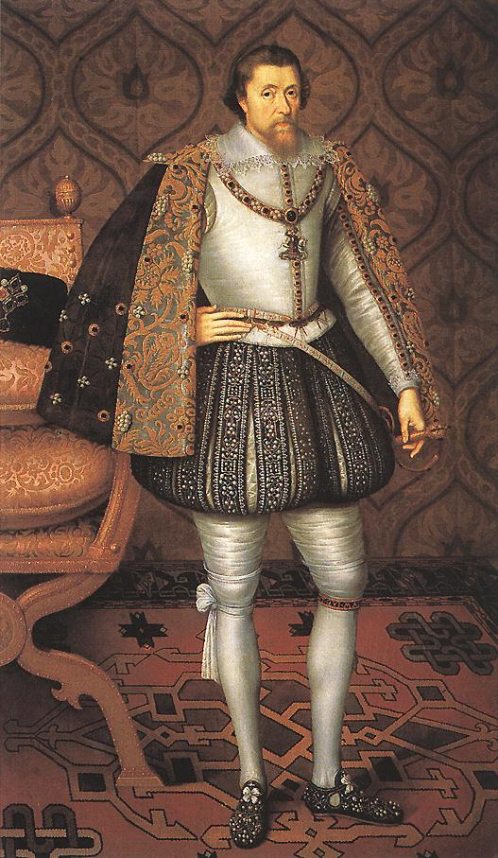
King James ends the party!
Hated tobacco
Considered the House of Burgesses a “seminary of sedition”
In 1624 he revokes charter, bankrupting the Virginia company and places Virginia under direct royal control
King James I of England

Slide 35
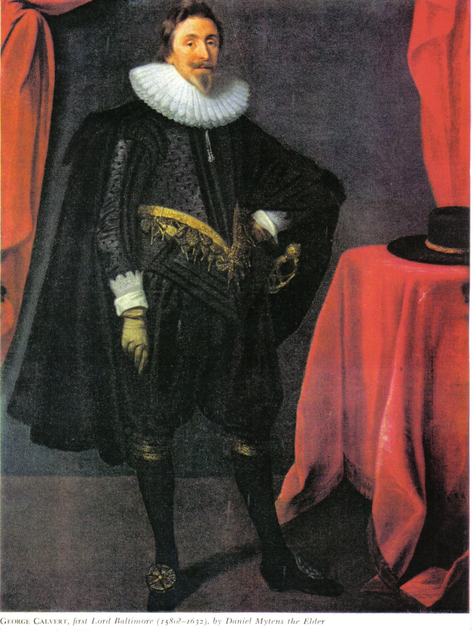
Maryland
Maryland founded in 1634 by Lord Baltimore, a prominent Catholic, under the absentee feudal relationship
Puts his Catholic relatives in charge of huge estates
“Catholic Haven” with tobacco as main crop
George Calvert, Lord Baltimore in 1632

Slide 36
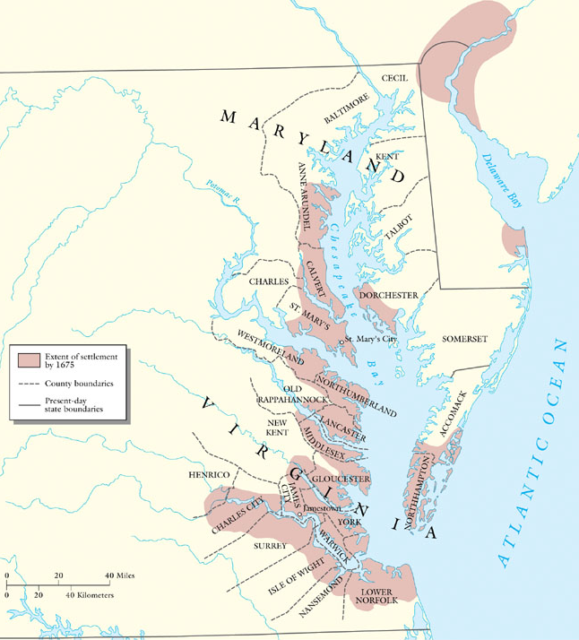
Maryland

Slide 37

St. Mary’s City, 1634

Slide 38

A Haven for Catholics
Poor Catholics worked their own land but came into conflict with Protestant backcountry farmers
Conflict erupts
Passes Act of Toleration in 1649
  Guaranteed freedom to all Christians
  Death penalty for those who do not believe in Jesus (Jews and atheists)
Original copy MD Toleration Act 1649

Slide 39


Slavery in the West Indies
By 1700 slaves outnumber whites 4 to 1
Barbados slave codes
Landowners were overcrowded in Jamaica and sought to establish the same system (encomienda) in southern colonies
Left: Slaves working in sugar fields
Right: Slave being “branded”

Slide 40

The Carolinas
The “Restoration” Period
Charles II, granted land to his 8 favorites (Lord Proprietors)
They wanted to supply the West Indies with food stuff, and export non-English products like wine, silk, and olive oil
Slavery soon took hold, and even Indians (Manacled) were rounded up and sold into slavery
By 1710 Indians were annihilated before they could flee to Pennsylvania “thinning of savannahs”
Indian slave in Colonial America

Slide 41

Rice is King!
Rice emerges as the staple crop
High price paid for slaves who had previous experience with this crop
Africans mostly immune from malaria which was rampant in the hot, swampy Carolinas
Charles Town soon becomes busiest port in south (Religious toleration)
Slave digging rice paddy

Slide 42

North Carolina
Squatters and poverty stricken settlers trickle down from Virginia into North Carolina
Strong spirit of resistance
Dubbed “a bale of humanity between two mountains of conceit”
Series of Indian Wars
  Tuscarora War
  Yamasee Indians uprising

Slide 43


Georgia
Last of 13 Colonies
Served as a “buffer”
James Oglethorpe intended it to be a “Charity Colony” attracting mostly debtors.
Top: Early Georgia, Below: James Oglethorpe

Slide 44

The Buffer Colony
Religious toleration except Catholics
Keep slavery and alcohol out! (By 1750 slavery and liquor was in)
Grew very slowly due to unhealthy climate, slave restrictions, and Spanish attacks

Slide 45


Savannah
Grew as a great port city
Diverse community
  Catholics not welcome!
Missionaries worked hard to convert Indians and debtors- John Wesley
Above: Port city of Savannah in early days
Below: Plantation Modern Savannah

Slide 46
Homework:
Read Ch. 3 and Complete Ch. 2& 3 Reinforcement Packet

